Slide 1
Principal Component Analysis(PCA)

Slide 2

Principal Component Analysis
Principal component analysis (PCA) is a statistical procedure that uses an orthogonal transformation to convert a set of observations of possibly correlated variables into a set of values of linearly uncorrelated variables called principal components.
OR
PCA also called Principal component analysis is used for reducing the dimension of the dataset to a lower dimension
  where it can be analyzed more easily
  and also keep all the relevant information of the dataset without any loss.
High Dimension Data → Low Dimension Data

Slide 3
Principal Component Analysis
When to use PCA?
  To reduce the number of dimensions in your factor analysis.
  To categorize the dependent and independent variables in your data
  To eliminate the noise components in your dimension analysis

Slide 4
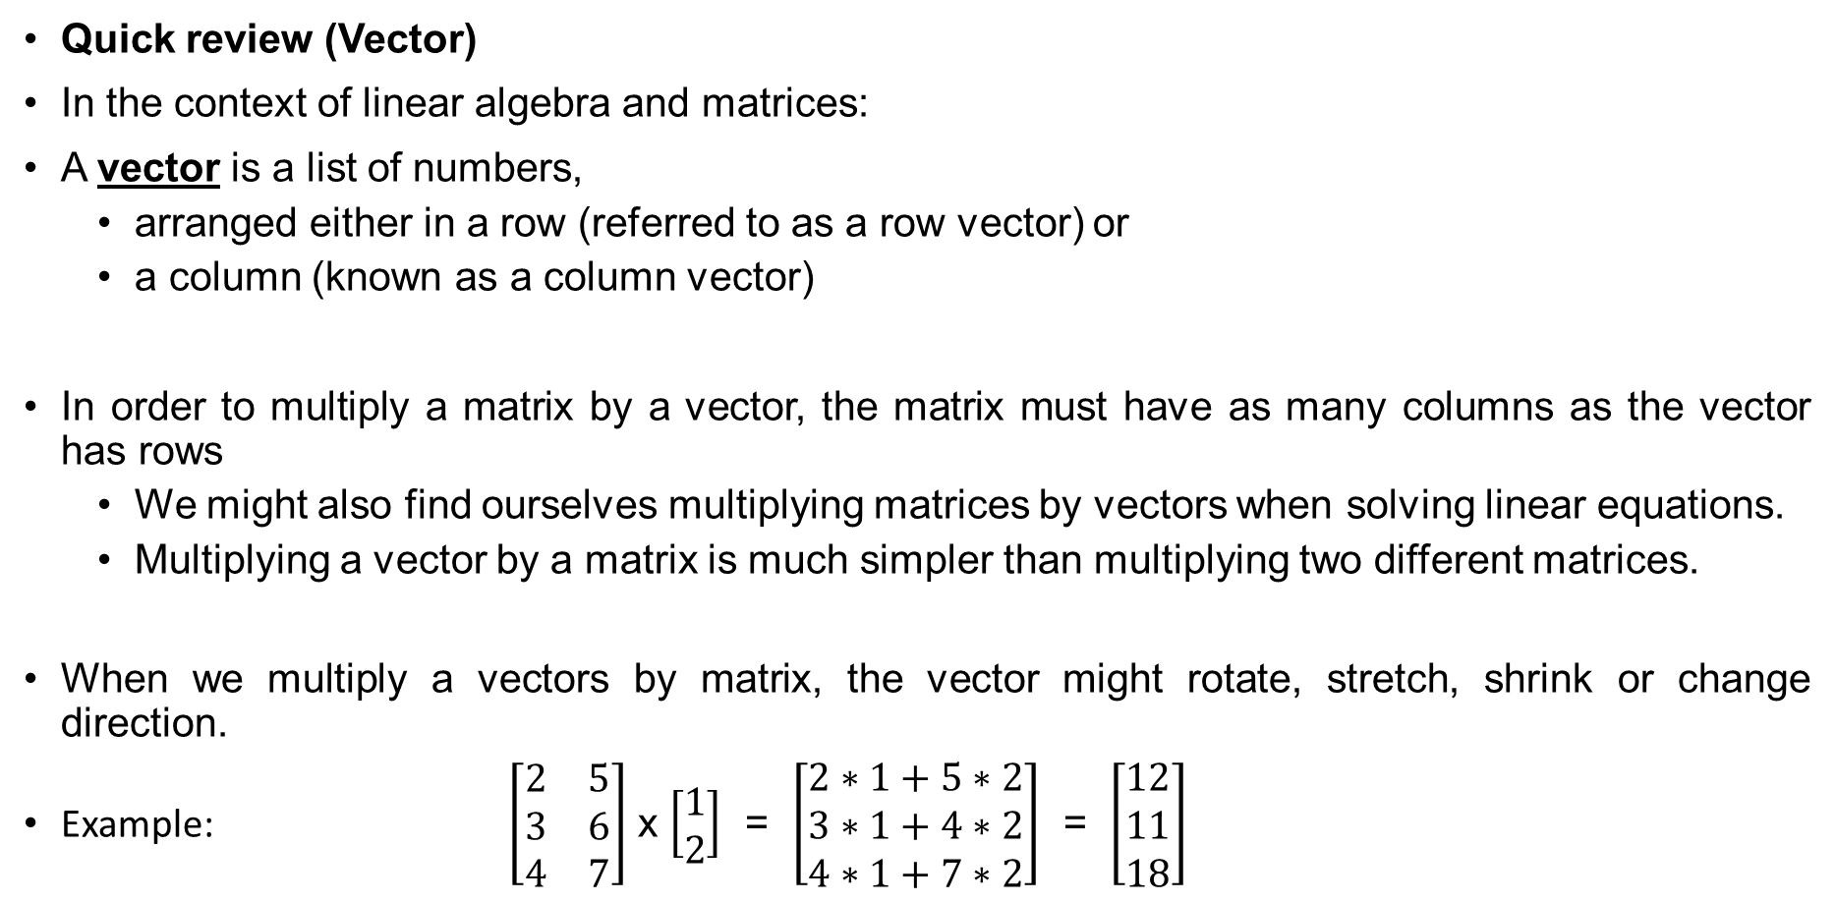
Principal Component Analysis
Quick review (Vector)
In the context of linear algebra and matrices:
A vector is a list of numbers,
  arranged either in a row (referred to as a row vector) or
  a column (known as a column vector)
In order to multiply a matrix by a vector, the matrix must have as many columns as the vector has rows
  We might also find ourselves multiplying matrices by vectors when solving linear equations.
  Multiplying a vector by a matrix is much simpler than multiplying two different matrices.
When we multiply a vectors by matrix, the vector might rotate, stretch, shrink or change direction.
Example: $\left[\begin{matrix}2 & 5 \\ 3 & 6 \\ 4 & 7\end{matrix}\right]$ x $\left[\begin{matrix}1 \\ 2\end{matrix}\right]$ = $\left[\begin{matrix}2∗1+5∗2 \\ 3∗1+4∗2 \\ 4∗1+7∗2\end{matrix}\right]$ = $\left[\begin{matrix}12 \\ 11 \\ 18\end{matrix}\right]$

Slide 5
Principal Component Analysis
Quick review (Eigenvector and Eigenvalue)
An eigenvector is a non-zero vector that doesn't change direction when a linear transformation is applied to it ( when you multiply it by a matrix)
Eigenvectors are those vectors that are only stretched, with neither rotation nor trim, and keep pointing in the same direction.
The corresponding eigenvalue is the factor by which an eigenvector is stretched or compressed.
  If the eigenvalue is negative, the eigenvector's direction is reversed.
Consider an n × n matrix A and a nonzero vector v of length n. If multiplying A with v denoted by Av simply scales v by a factor of λ, where λ is a scalar, then v is called an eigenvector of A, and λ is the corresponding eigenvalue.
How much eigen vector is stretched or compressed:
  If λ = 2 => eigenvector is twice as long
  If λ = 0.5 => eigenvector is half as long

Slide 6
Principal Component Analysis
Quick review (Eigenvector and Eigenvalue)
We will be using the formula: det(S- λI)=0
  Where
  det: determinent (scalar valued function of the entries of a square matrix)
  S or A: Matrix
  λ: eigenvalue of S
  I : N x N identity matrix

Slide 7
Principal Component Analysis
Quick review (Covariance Matrix)
Covariance: measure of joint variability of 2 random variables
  shows the tendency in the linear relationship between the variables
A covariance matrix (also known as auto-covariance matrix, dispersion matrix, variance matrix, or variance–covariance matrix)
  is a square matrix giving the covariance between each pair of elements of a given random vector.

Slide 8
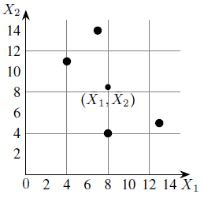

Principal Component Analysis
Let us understand PCA by an example for conversion of date from 2D to 1D
Reduce the 2D data given below to 1D data:
Step 1: Calculate Mean (One can also use Z-Normalization)
  $μx1$= $\frac{4+8+13+7}{4}$ = 8
  $μx2$= $\frac{11+4+5+14}{4}$ = 8.5
Feature | Example 1 | Example 2 | Example 3 | Example 4
X₁ | 4 | 8 | 13 | 7
X₂ | 11 | 4 | 5 | 14

Slide 9
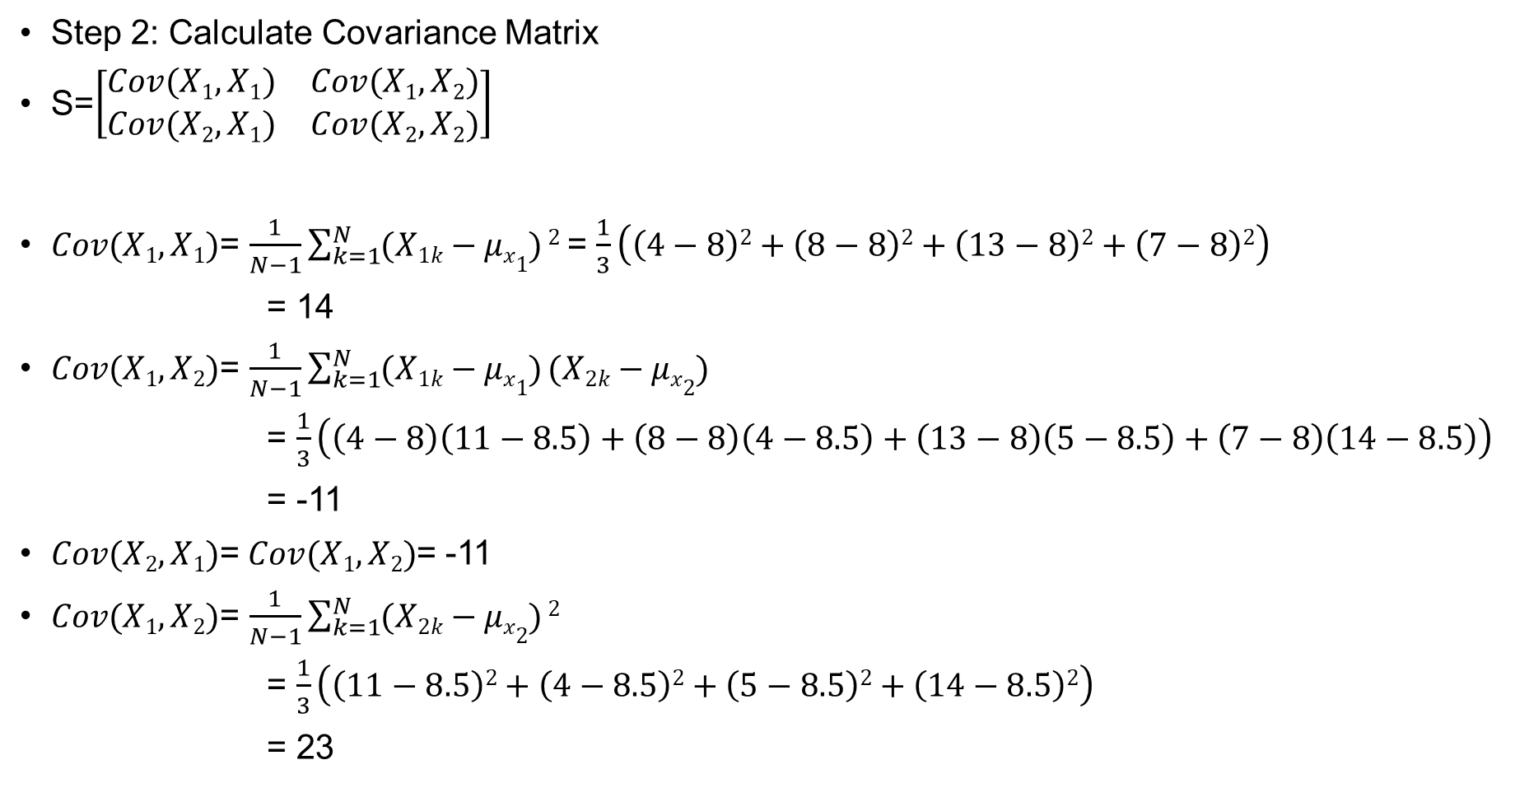

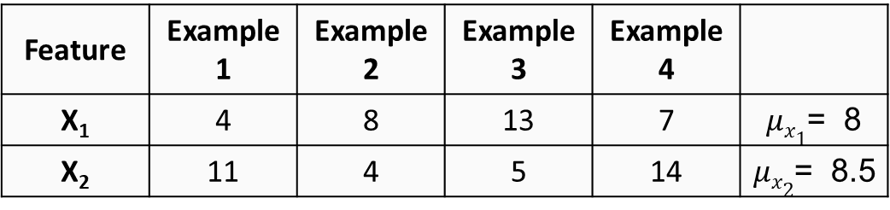
Principal Component Analysis
Feature | Example 1 | Example 2 | Example 3 | Example 4
X₁ | 4 | 8 | 13 | 7 | $μx1$= 8
X₂ | 11 | 4 | 5 | 14 | $μx2$= 8.5
Step 2: Calculate Covariance Matrix
S=$\left[\begin{matrix}Cov(X1,X1) & Cov(X1,X2) \\ Cov(X2,X1) & Cov(X2,X2)\end{matrix}\right]$
$Cov(X1,X1)$= $\frac{1}{N−1}\sum_{k=1}^{N}{(X1k−μx1)}2$ = $\frac{1}{3}\left(\left(4−8\right)2+\left(8−8\right)2+\left(13−8\right)2+\left(7−8\right)2\right)$
= 14
$Cov(X1,X2)$= $\frac{1}{N−1}\sum_{k=1}^{N}{(X1k−μx1)}(X2k−μx2)$
= $\frac{1}{3}\left(\left(4−8\right)\left(11−8.5\right)+\left(8−8\right)\left(4−8.5\right)+\left(13−8\right)\left(5−8.5\right)+\left(7−8\right)\left(14−8.5\right)\right)$
= -11
$Cov(X2,X1)$= $Cov(X1,X2)$= -11
$Cov(X1,X2)$= $\frac{1}{N−1}\sum_{k=1}^{N}{(X2k−μx2)}2$
= $\frac{1}{3}\left(\left(11−8.5\right)2+\left(4−8.5\right)2+\left(5−8.5\right)2+\left(14−8.5\right)2\right)$
= 23
So, Covariance Matrix:
S=$\left[\begin{matrix}14 & −11 \\ −11 & 23\end{matrix}\right]$

Slide 10

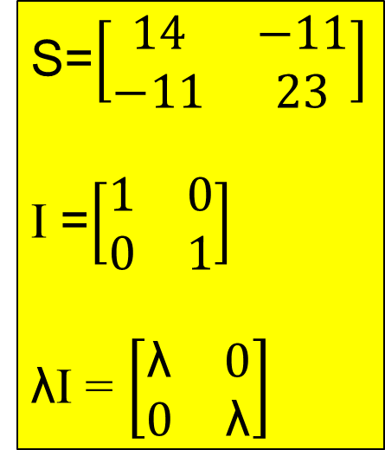
Principal Component Analysis
Feature | Example 1 | Example 2 | Example 3 | Example 4
X₁ | 4 | 8 | 13 | 7 | $μx1$= 8
X₂ | 11 | 4 | 5 | 14 | $μx2$= 8.5
Step 3: Eigenvalues of Covariance Matrix
The characteristic equation of the covariance matrix is,
0 = det(S- λI)
= $\left|\begin{matrix}14−\text{λ} & −11 \\ −11 & 23−\text{λ}\end{matrix}\right|$
= ($14−\text{λ}$)($23−\text{λ}$) – (-11) (-11)
= $\text{λ}$² - 37 $\text{λ}$+ 201
S=$\left[\begin{matrix}14 & −11 \\ −11 & 23\end{matrix}\right]$
I =$\left[\begin{matrix}1 & 0 \\ 0 & 1\end{matrix}\right]$
λI = $\left[\begin{matrix}\text{λ} & 0 \\ 0 & \text{λ}\end{matrix}\right]$

Slide 11

Principal Component Analysis
Feature | Example 1 | Example 2 | Example 3 | Example 4
X₁ | 4 | 8 | 13 | 7 | $μx1$= 8
X₂ | 11 | 4 | 5 | 14 | $μx2$= 8.5
Step 3: Eigenvalues of Covariance Matrix
= $\text{λ}$² - 37 $\text{λ}$+ 201
Finding the roots of the quadratic equation:
$\text{λ}$ = $\frac{−b±\sqrt{b^{2}−4ac}}{2a}$ = $\frac{−(−37)±\sqrt{{(−37)}^{2}−4(1)(201)}}{2(1)}$ = $\frac{37±\sqrt{567}}{2}$
$\text{λ}$₁ = $\frac{37 + 23.78}{2}$ = 30.39
$\text{λ}$₂ = $\frac{37 − 23.78}{2}$ = 6.61

Slide 12
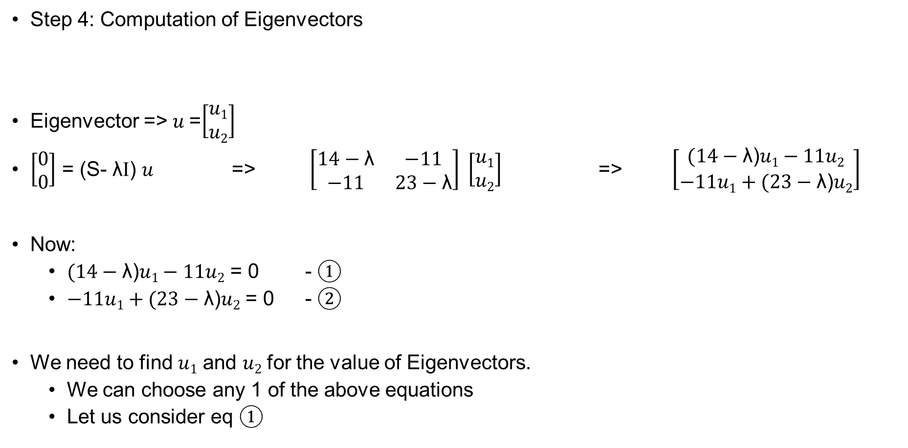
Principal Component Analysis
Feature | Example 1 | Example 2 | Example 3 | Example 4
X₁ | 4 | 8 | 13 | 7 | $μx1$= 8
X₂ | 11 | 4 | 5 | 14 | $μx2$= 8.5
Step 4: Computation of Eigenvectors
Eigenvector => $u$=$\left[\begin{matrix}u1 \\ u2\end{matrix}\right]$
$\left[\begin{matrix}0 \\ 0\end{matrix}\right]$ = (S- λI) $u$ => $\left[\begin{matrix}14−\text{λ} & −11 \\ −11 & 23−\text{λ}\end{matrix}\right] \left[\begin{matrix}u1 \\ u2\end{matrix}\right]$ => $\left[\begin{matrix}(14−\text{λ}\text{)}u1−11u2 \\ −11u1+(23−\text{λ}\text{)}u2\end{matrix}\right]$
Now:
  $(14−\text{λ}\text{)}u1−11u2$ = 0 - ①
  $−11u1+(23−\text{λ}\text{)}u2$ = 0 - ②
We need to find $u1$ and $u2$ for the value of Eigenvectors.
  We can choose any 1 of the above equations
  Let us consider eq ①

Slide 13


Principal Component Analysis
Feature | Example 1 | Example 2 | Example 3 | Example 4
X₁ | 4 | 8 | 13 | 7 | $μx1$= 8
X₂ | 11 | 4 | 5 | 14 | $μx2$= 8.5
$(14−\text{λ}\text{)}u1−11u2$ = 0
$(14−\text{λ}\text{)}u1$ = $11u2$
$\frac{u1}{11}$ = $\frac{u2}{(14−\text{λ}\text{)}}$ = t → where t is any real number
So
  $u1$ = 11t
  $u2$ = (14- $\text{λ}$)t
Taking t=1, we get eigenvector corresponding to Covariance Matrix as:
$u$=$\left[\begin{matrix}11 \\ 14−\text{λ}\end{matrix}\right]$

Slide 14
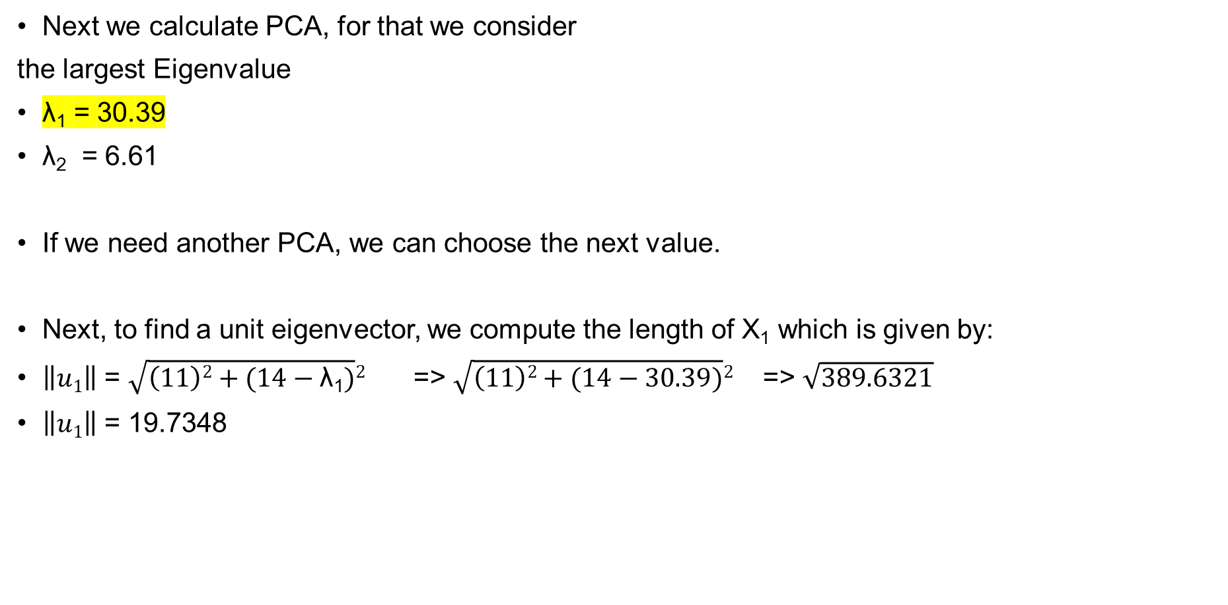
Principal Component Analysis
Feature | Example 1 | Example 2 | Example 3 | Example 4
X₁ | 4 | 8 | 13 | 7 | $μx1$= 8
X₂ | 11 | 4 | 5 | 14 | $μx2$= 8.5
Next we calculate PCA, for that we consider
the largest Eigenvalue
$\text{λ}$₁ = 30.39
$\text{λ}$₂ = 6.61
If we need another PCA, we can choose the next value.
Next, to find a unit eigenvector, we compute the length of X₁ which is given by:
$\left\|u1\right\|$ = $\sqrt{\left(11\right)2+(14−\text{λ}\text{1})}2$ => $\sqrt{\left(11\right)2+(14−\text{30.39})}2$ => $\sqrt{389.6321}$
$\left\|u1\right\|$ = 19.7348

Slide 15
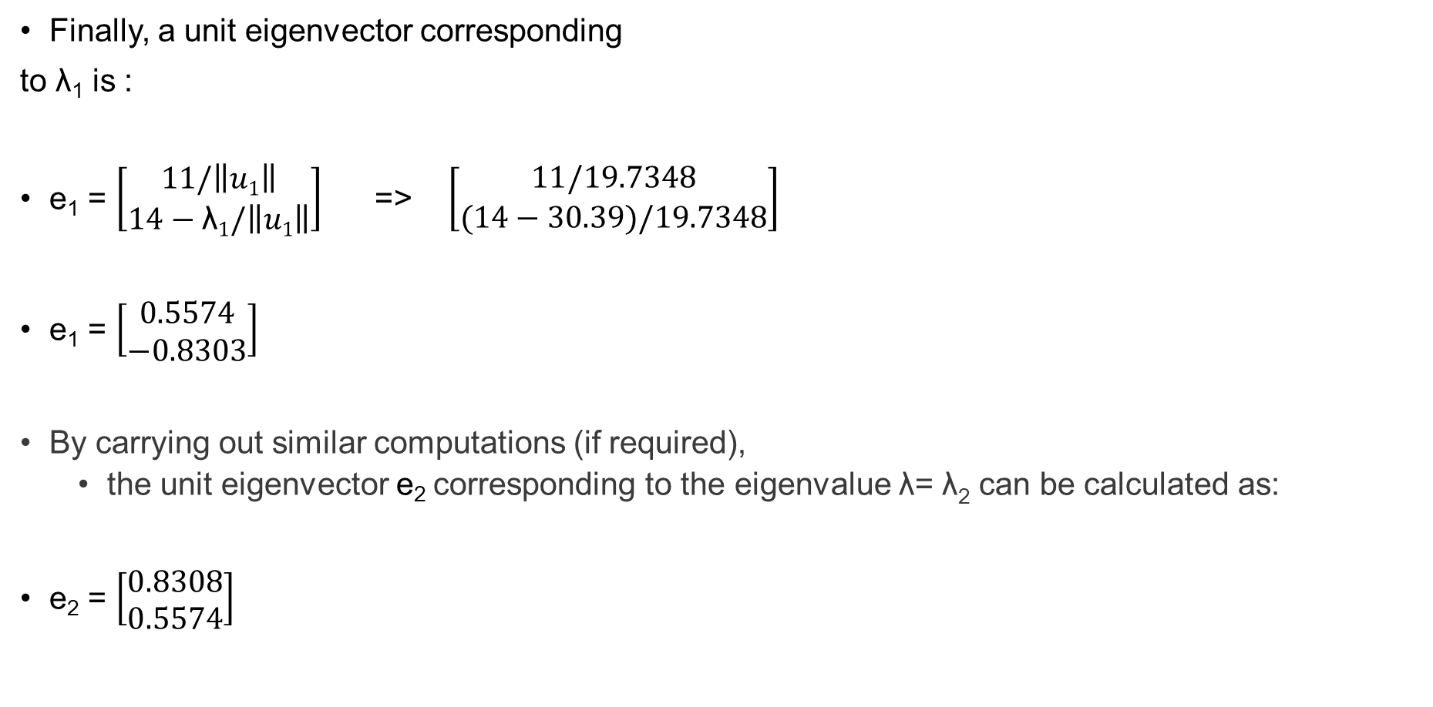
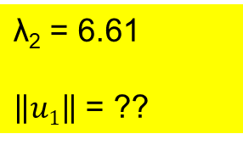
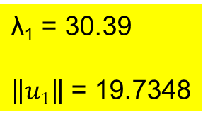
Principal Component Analysis
Feature | Example 1 | Example 2 | Example 3 | Example 4
X₁ | 4 | 8 | 13 | 7 | $μx1$= 8
X₂ | 11 | 4 | 5 | 14 | $μx2$= 8.5
Finally, a unit eigenvector corresponding
to λ₁ is :
e₁ = $\left[\begin{matrix}11/\left\|u1\right\| \\ 14−\text{λ}1/\left\|u1\right\|\end{matrix}\right]$ => $\left[\begin{matrix}11/19.7348 \\ (14−30.39)/19.7348\end{matrix}\right]$
e₁ = $\left[\begin{matrix}0.5574 \\ −0.8303\end{matrix}\right]$
By carrying out similar computations (if required),
  the unit eigenvector e₂ corresponding to the eigenvalue λ= λ₂ can be calculated as:
e₂ = $\left[\begin{matrix}0.8308 \\ 0.5574\end{matrix}\right]$
$\text{λ}$₁ = 30.39
$\left\|u1\right\|$ = 19.7348
$\text{λ}$₂ = 6.61
$\left\|u1\right\|$ = ??

Slide 16

Principal Component Analysis
Feature | Example 1 | Example 2 | Example 3 | Example 4
X₁ | 4 | 8 | 13 | 7 | $μx1$= 8
X₂ | 11 | 4 | 5 | 14 | $μx2$= 8.5
Step 5: Compute first principal components
Let $\left[\begin{matrix}X1k \\ X2k\end{matrix}\right]$
be the kth sample in the above Table (dataset).
The first principal component of this example is given by:
e₁^{T} $\left[\begin{matrix}X1k −μx1 \\ X2k −μx2\end{matrix}\right]$ => $\left[\begin{matrix}0.5574 & −0.8303\end{matrix}\right]$ $\left[\begin{matrix}X1k −μx1 \\ X2k −μx2\end{matrix}\right]$
= (0.5574) ($X1k −μx1$) + (-0.8303) ($X2k −μx2$)

Slide 17

Principal Component Analysis
Feature | Example 1 | Example 2 | Example 3 | Example 4
X₁ | 4 | 8 | 13 | 7 | $μx1$= 8
X₂ | 11 | 4 | 5 | 14 | $μx2$= 8.5
First Principal Component for Example1:
$\left[\begin{matrix}0.5574 & −0.8303\end{matrix}\right]$ $\left[\begin{matrix}X11 −μx1 \\ X21 −μx2\end{matrix}\right]$
$\left[\begin{matrix}X11 \\ X21\end{matrix}\right]$ = $\left[\begin{matrix}4 \\ 11\end{matrix}\right]$
= (0.5574) ($4 −8$) + (-0.8303) ($11 −8.5$) => -4.30535

Slide 18
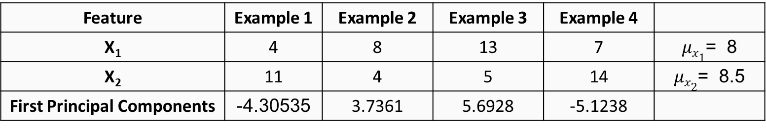
Principal Component Analysis
D.I.Y. you may solve it for all examples :
Feature | Example 1 | Example 2 | Example 3 | Example 4
X₁ | 4 | 8 | 13 | 7 | $μx1$= 8
X₂ | 11 | 4 | 5 | 14 | $μx2$= 8.5
First Principal Components | -4.30535 | 3.7361 | 5.6928 | -5.1238

Slide 19
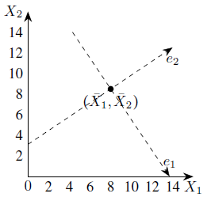

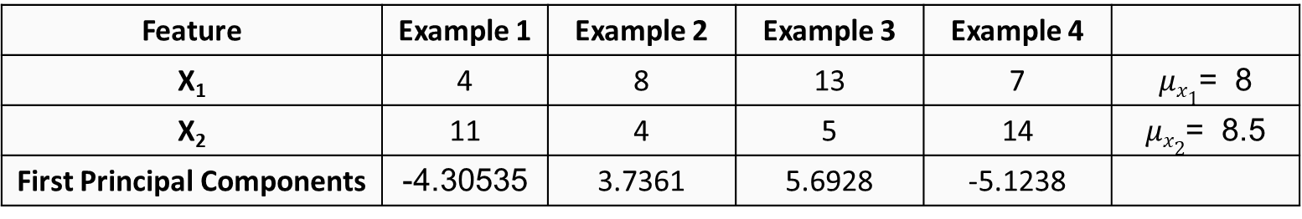
Principal Component Analysis
Step 6: Geometrical meaning of first principal components
First, we shift the origin to the “center” => ($μx1$, $μx2$)
and then change the directions of coordinate axes
to the directions of the eigenvectors e₁ and e₂
Feature | Example 1 | Example 2 | Example 3 | Example 4
X₁ | 4 | 8 | 13 | 7 | $μx1$= 8
X₂ | 11 | 4 | 5 | 14 | $μx2$= 8.5
First Principal Components | -4.30535 | 3.7361 | 5.6928 | -5.1238
The coordinate system for principal components

Slide 20
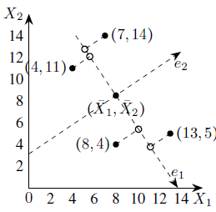
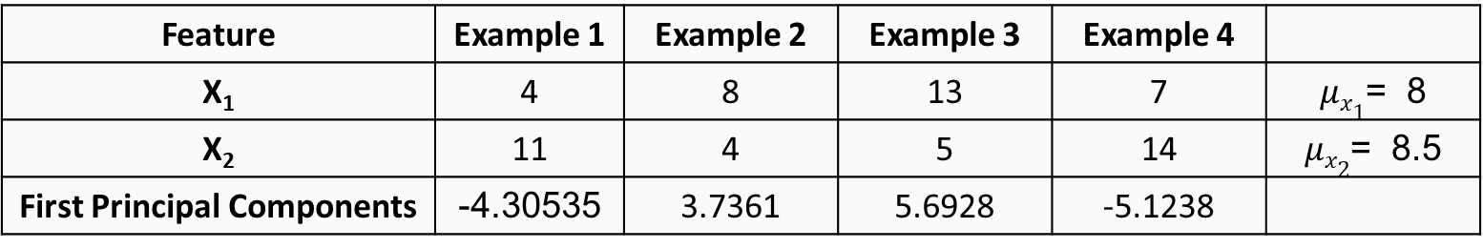
Principal Component Analysis
Next, we drop perpendiculars from the given data points to the e1-axis
Feature | Example 1 | Example 2 | Example 3 | Example 4
X₁ | 4 | 8 | 13 | 7 | $μx1$= 8
X₂ | 11 | 4 | 5 | 14 | $μx2$= 8.5
First Principal Components | -4.30535 | 3.7361 | 5.6928 | -5.1238
Projections of data points on the axis of the first principal component

Slide 21
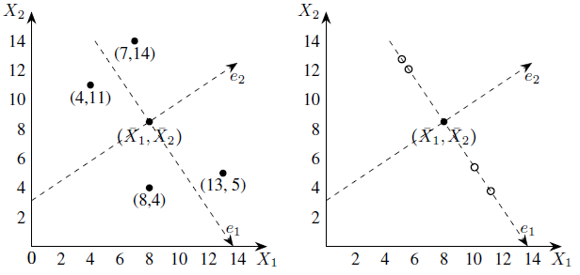
Principal Component Analysis
The first principal components are the e1-coordinates of the feet of perpendiculars, that is, the projections on the e1-axis.
The projections of the data points on the e1-axis may be taken as approximations of the given data points hence we may replace the given data set with these points.
Now, each of these approximations can be unambiguously specified by a single number, namely, the e1-coordinate of approximation.
Thus the two-dimensional data set can be represented approximately by the following one-dimensional data set.
Geometrical representation of one-dimensional approximation to the data set

Slide 22
THANK YOU

